Slide 1
Presented By:
YASH JAISWAL

Slide 2
BLACK FRIDAY PREDICTION
1) Customer purchase behaviour
2) November 24
3) various products of different categories.
4) Big Discount

Slide 3
Problem Statement
A retail company “ABC Private Limited” wants to understand the customer purchase behaviour (specifically, purchase amount) against various products of different categories. They have shared purchase summary of various customers for selected high volume products from last month. The data set also contains customer demographics (age, gender, marital status, city_type, stay_in_current_city), product details (product_id and product category) and Total purchase_amount from last month. Now, they want to build a model to predict the purchase amount of customer against various products which will help them to create personalized offer for customers against different products.

Slide 4
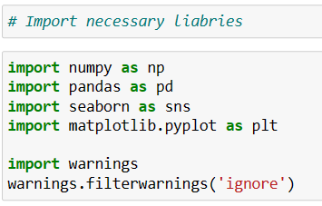
Libraries

Slide 5
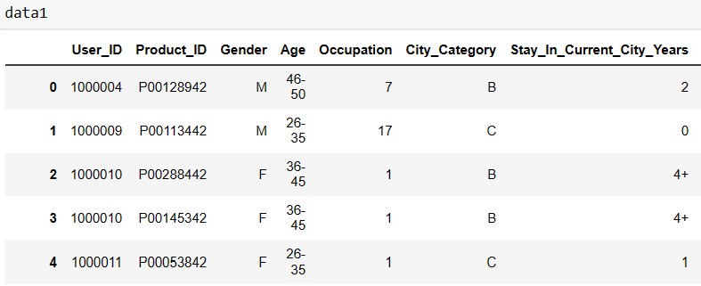
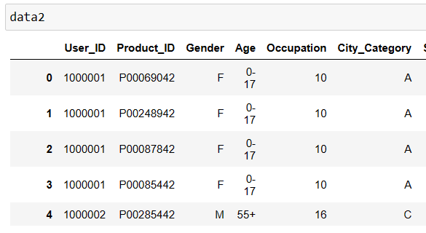
DATASET

Slide 6
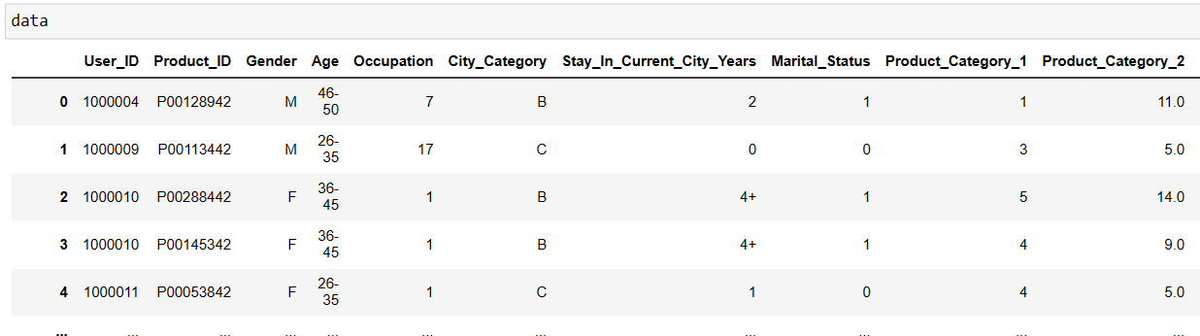
DATASET JOIN WITH CONCAT

Slide 7
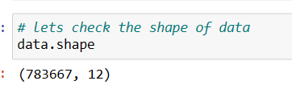
DATASET SHAPE

Slide 8
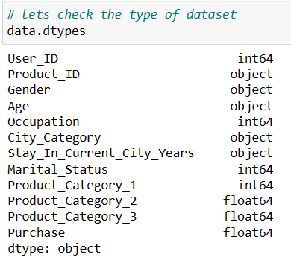
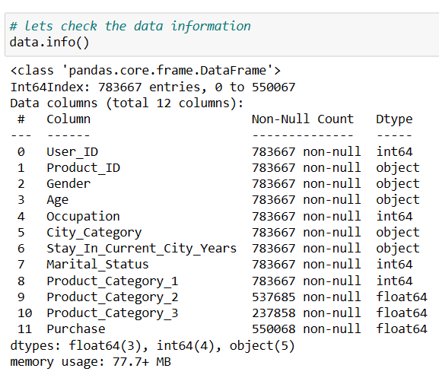
Exploratory Data Analysis(EDA)

Slide 9
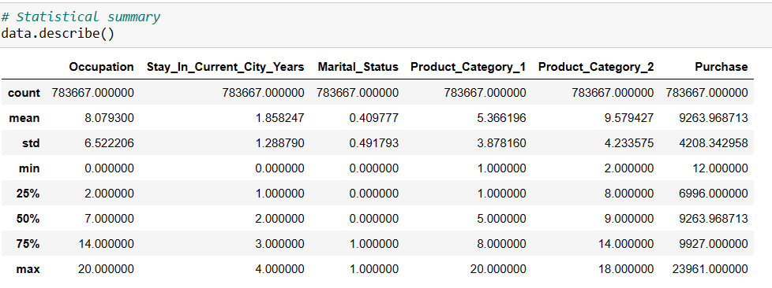
Statistical summary

Slide 10
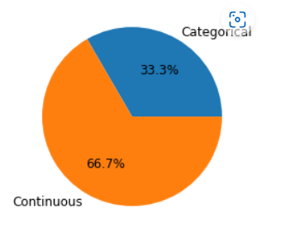
Categorical and Continues Columns

Slide 11
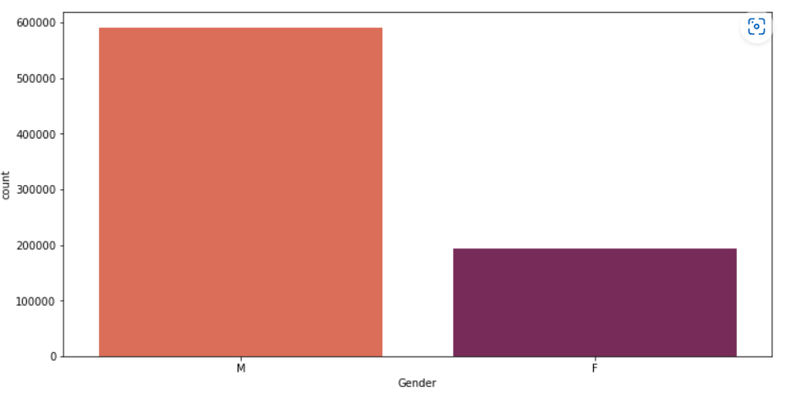
GENDER

Slide 12
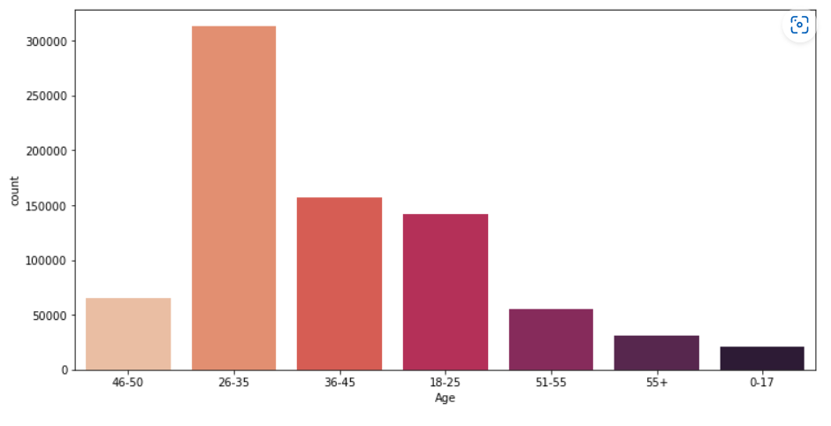
AGE

Slide 13
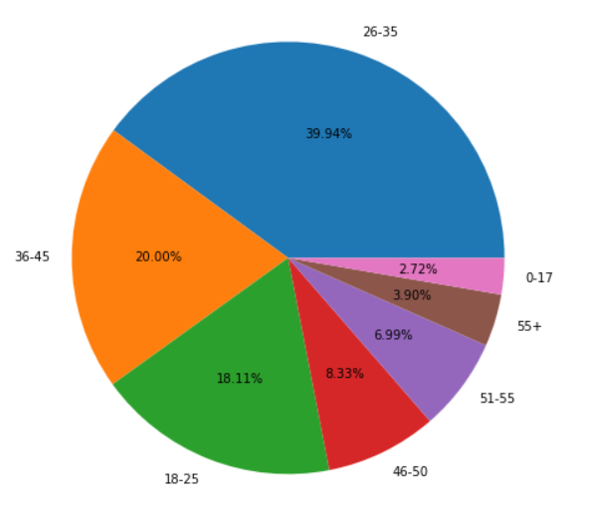
AGE DISTRIBUTION

Slide 14
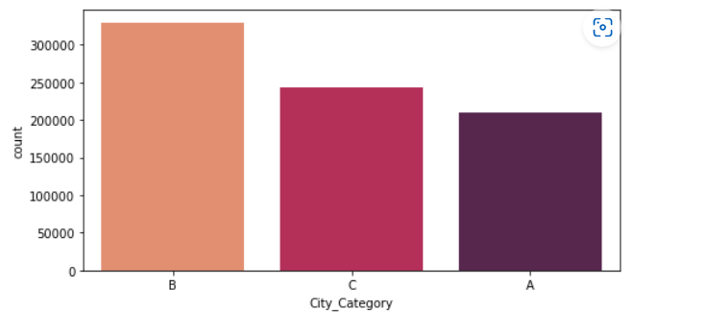
City Category

Slide 15
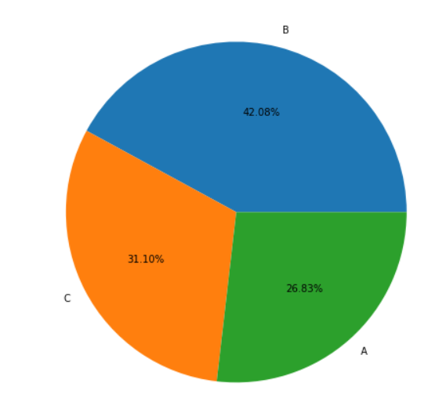
City Category Distribution

Slide 16
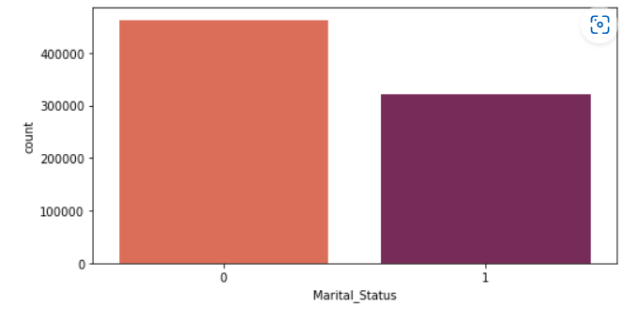
Marital Status

Slide 17
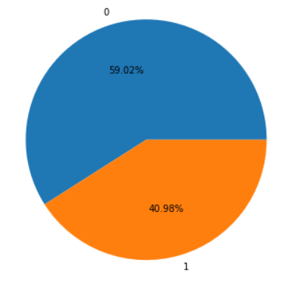
Marital Status Distribution

Slide 18
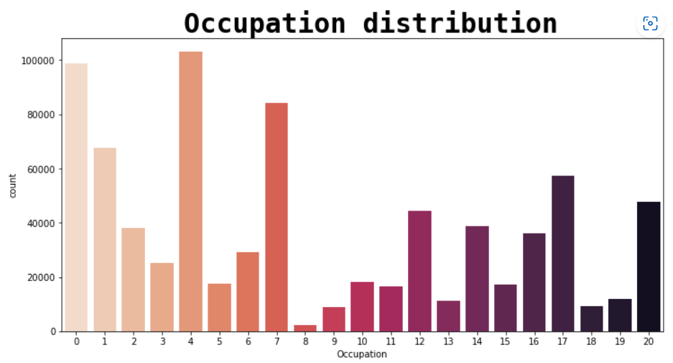
Occupation Distribution

Slide 19
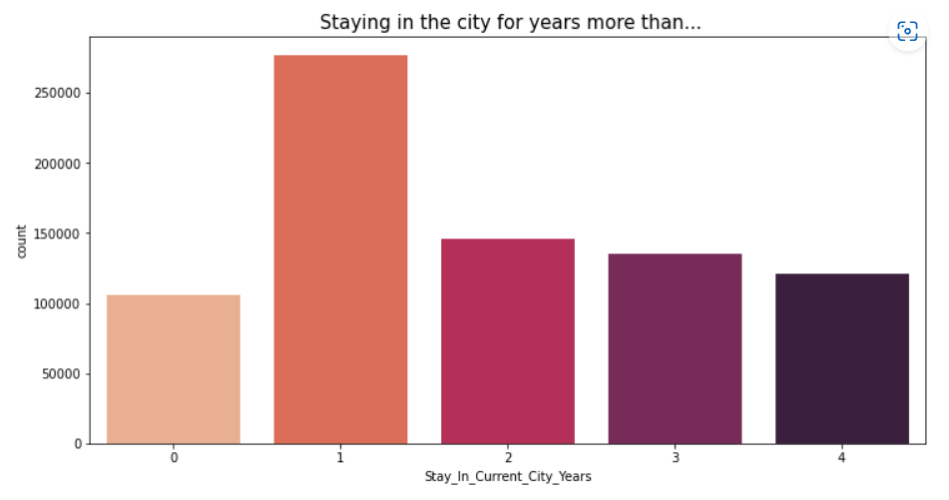
Staying in Current city year

Slide 20
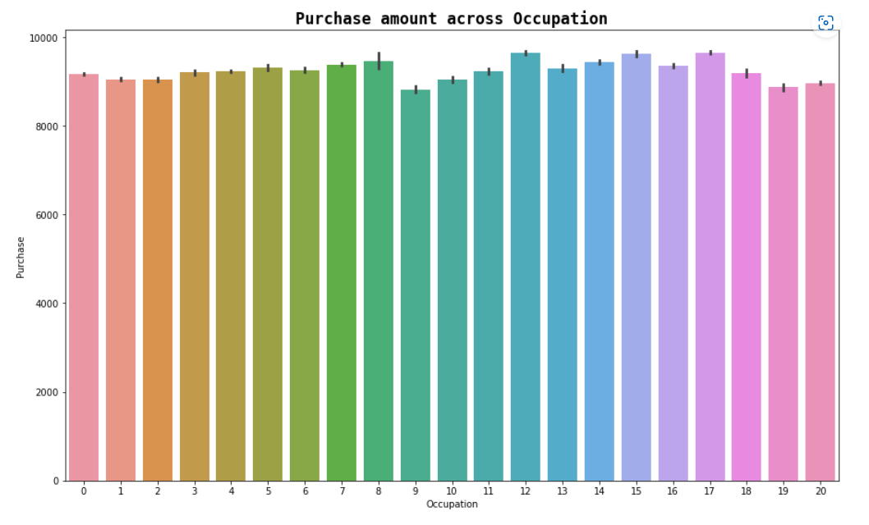
Occupation

Slide 21
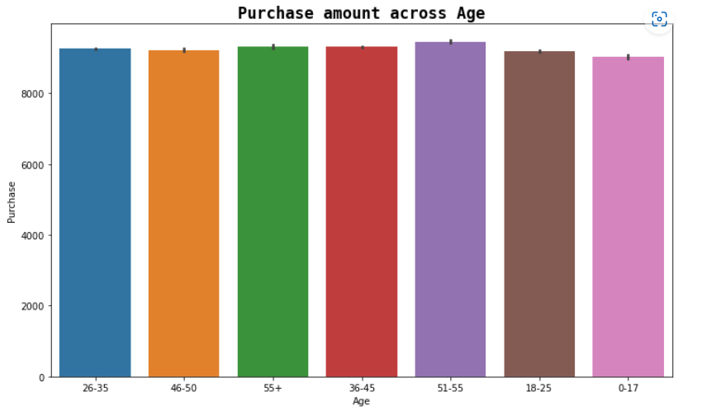
Purchase amount across Age

Slide 22
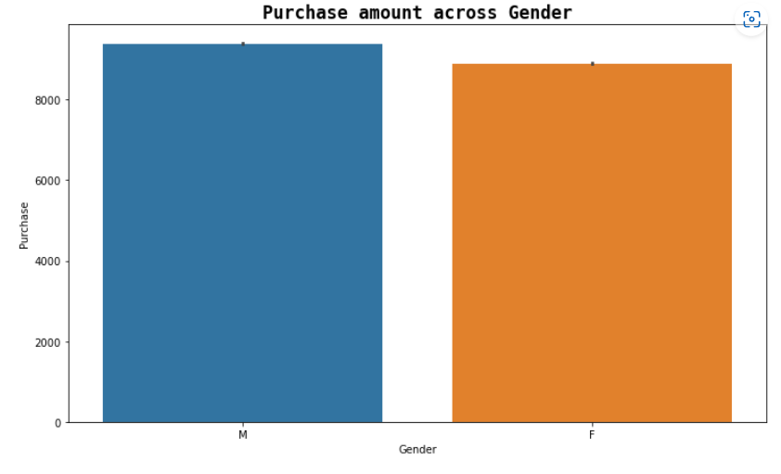
Purchase amount across Gender

Slide 23
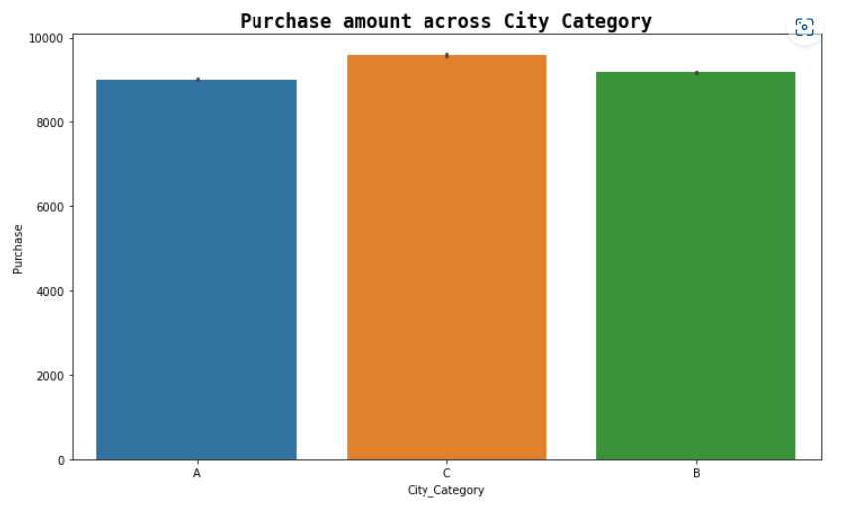
Purchase amount across City Category

Slide 24
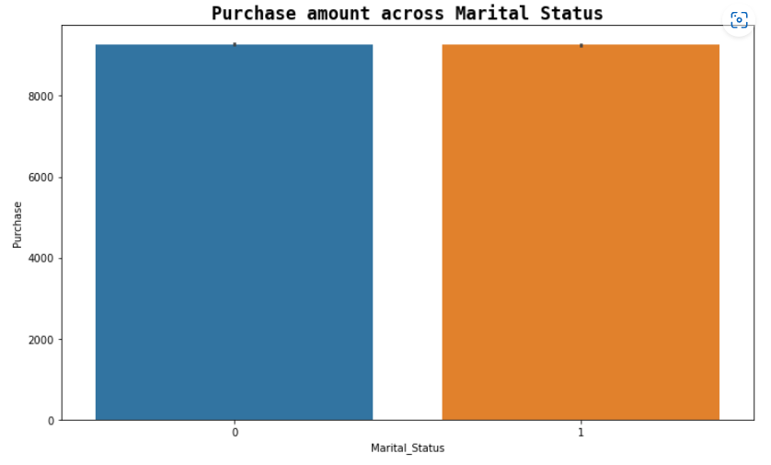
Purchase amount across Marital status

Slide 25
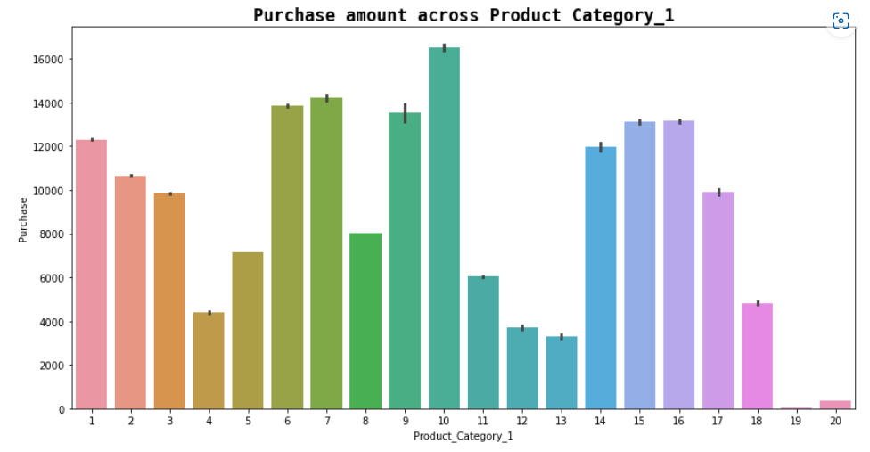
Purchase amount across Product category_1

Slide 26
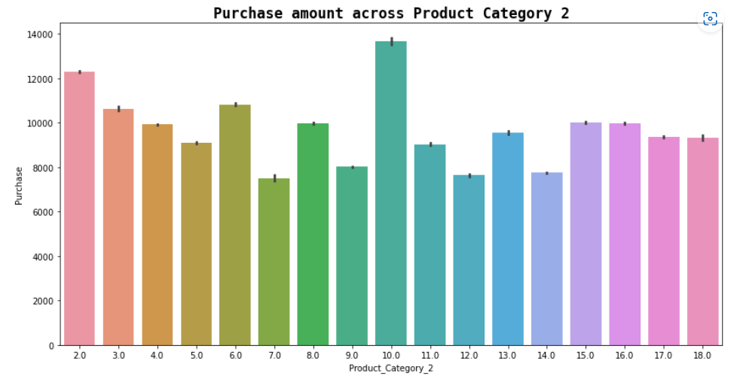
Purchase amount across Product category_2

Slide 27
CONCLUSION
1) After visualizing the data. I found Black Friday is the best online shopping day because Male and female both of use to shopping more.
2) customer satisfaction and customer trust appeared as the outcomes of overall Retail Company
3) 24 November is Black Friday

Slide 28

Flip ROBO Technologies

